Slide 1
transforming & analyzing data: SQL Project
Niki Yaw
MARCH 2023

Slide 2
Purpose & goals
STUDY & IDENTIFY TRENDS USING DATA OBTAINED FROM WEB TRAFFIC IN CERTAIN SITES
BUSINESS STANDPOINT: IMPORTANT TO IDENTIFY POTENTIAL CUSTOMERS & SPENDING HABITS
LOCATIONS OF CUSTOMERS
TOTAL GENERATED REVENUE
POPULAR PRODUCTS (CATEGORIES)
Notes:
Crucial to gather all the information about your customers you can get your hands on
Better to identity potential customers and learn more about their spending habits

Slide 3
WHAT I DID
1. SCHEME THROUGH THE TABLES AND TRY TO MAKE SENSE OF THE DATA THAT THEY REPRESENT.
SALES_REPORT -> PRODUCTS THAT WERE SOLD; STOCKLEVEL
2. START THE DATA CLEANING DATA PROCESS (WHILE KEEPING THE BIGGER PICTURE IN MIND).
PRODUCTS -> WHAT IS SENTIMENTSCORE, SENTIMENTMAGNITUDE? IDK TBH
ALL_SESSIONS -> KEPT ALL THE COLUMNS BUT IGNORE THEM
3. ASK THE RIGHT QUESTIONS TO EXTRACT IMPORTANT AND USEFUL INFORMATION USING THE SEMI-CLEAN DATA.
Notes:
Initial and primary phase in data cleaning
- Keep everything intact as best as I can

Slide 4
DATA CLEANING
1. IDENTITY DUPLICATED ROWS
- WINDOW FUNCTIONS (ROW_NUMBER(), PARTITION BY, ORDER BY)
2. REPLACE INCONSISTENT DATA VALUES (COLUMNS: COUNTRY, CITY)
- ‘(NOT SET)’ OR ‘NOT AVAILABLE IN DEMO DATASET’ -> NULL
- CASE WHEN
3. ADDRESS MISSING VALUES (COLUMN: TIMEONSITE)
- COALESCE FUNCTION & PERCENTILE_CONT(0.5)
4. REMOVE REDUNDANT OBSERVATIONS (COLUMNS: V2PRODUCTNAME, V2PRODUCTCATEGORY)
- CASE WHEN & REPLACE()

Slide 5
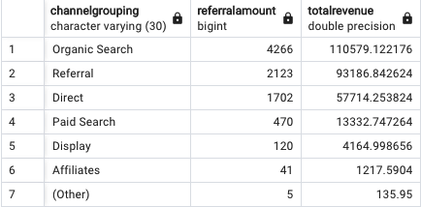
Q1: WHICH CHANNELS ARE THE MOST POPULAR IN THE UNTIED STATES?
ALL_SESSIONS: CHANNELGROUPING, PRODUCTPRICE
ORGANIC SEARCH ALSO GENERATES THE HIGHEST REVENUE
BUT!!

Slide 6
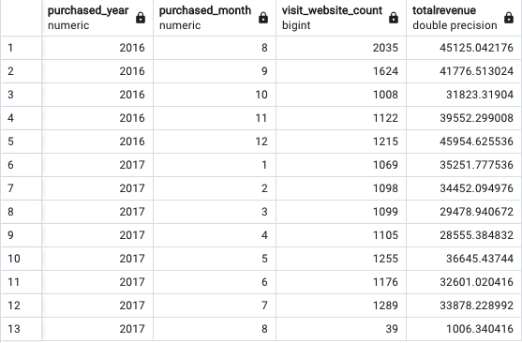
Q2: WHAT TIME OF YEAR HAS THE HIGHEST SALES?
ALL_SESSIONS: DATE
HIGHEST: AUGUST 2016 & DEC 2016
LOWEST: OCT 2016 & JUNE 2017

Slide 7
FUTURE IMPROVEMENTS
BETTER TABLE FORMATIONS
ALL_SESSIONS – BREAK UP INTO MULTIPLE TABLES
MULTIPLE NULL COLUMNS
PRODUCT% COLUMNS
ECOMMERCE% COLUMNS
ANALYTICS
AUTOMATE THE DELETION OF DUPLICATE RECORDS?? (IF THAT IS POSSIBLE)
Notes:
Fix the backbone of the issue (table)
Might solve messy/duplicated data issues
Better named columns
Combine with products?
Another table about ecommerce field?

